Slide 1
Roll Up Your Sleeve for Good Health
Bonnie L. Hinds
July 2012
June 2012

Slide 2
“An ounce of PREVENTION
is worth a pound of
cure.”
Henry de Bracton
1210-1268
Average life expectancy
in 1200s –
43
Notes:
De Bracton was an English lawyer and cleric. His convictions regarding prevention obviously paid off, granting him an extra 15 years beyond the average life span.

Slide 3
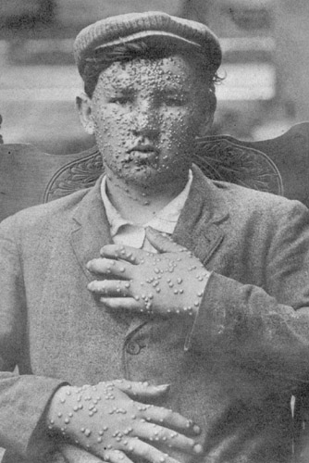
Vaccines are considered to be
the most important advancement (!)
in the history of human health.
One of history’s deadliest diseases, with a mortality rate of 30-35 percent or more,
smallpox has been
totally eradicated due to
vaccinations.
Eradicated - 100 percent
eliminated worldwide.
Notes:
Smallpox was a worldwide scourge for CENTURIES, killing and permanently debilitating millions of people. Those who survived the disease often suffered significant scarring, blindness, and loss of tissue on the nose, lips, and ears. It is estimated that 400 million people died of smallpox across the world in the 20th century alone. Smallpox is still the only disease that has been 100% eradicated. The last known case was in 1977.

Slide 4
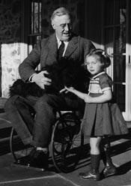
Vaccine-Preventable Diseases
Polio – Virtually eliminated in the U.S. and western hemisphere by the 1980s.
Viral illness, affecting the nervous system.
Victims may be permanently paralyzed. Respiratory paralysis results in death.
U.S. epidemic in 1952.
Vaccine introduced in
1955.

Slide 5
Silly Grownups:
Shots are NOT just for kids:
The “trix” of preventing
illness through vaccines
applies to older adults, too!
Notes:
Most people are well aware of inoculations for infants and young children, but believe—erroneously—that the need for vaccinations ends in early childhood.

Slide 6
Senior Health Considerations
An individual’s immune system becomes less responsive to
health assaults as he/she ages, rendering illness both more
likely and potentially more serious.
Chronic health conditions associated with aging (e.g., hypertension, diabetes, arthritis, etc.) can also make recovery slower and more difficult.
Notes:
Simply by virtue of being older—even without any other chronic health conditions—immunity is WANING, rendering the body susceptible to infection and illness.

Slide 7
Recommended Vaccinations for
Seniors
Flu
Pneumonia
Td(ap)
(Tetanus, diptheria, pertussis)
Shingles

Slide 8
Influenza (the “flu”)
On average, 36,000 Americans die from the seasonal flu each year. As many as 90 percent
of these deaths are to those aged 65 or older.
Flu shots are required annually, as vaccines are reformulated each year to best combat the particular strain circulating in any given flu season.
An annual flu shot is covered by
Medicare.
Notes:
Encourage everyone you know to get a flu shot. Flu shots are recommended for EVERYONE over the age of six months.

Slide 9
Flu season typically runs from October through
May each year, peaking most often in
January and February.
Maximum antibody production completed
two weeks after vaccination.
Effectiveness of shots dependent on vaccine
“match,” which is determined in February.
Formulation decision of the Food and
Drug Administration (FDA).
Notes:
Research and surveillance on influenza and trends conducted in 130 flu centers in 101 nations. In February, WHO makes a recommendation as to the best formulation, but each nation decides for itself what to include in its vaccines. The FDA makes the decision for the US. Some years the formulation is spot on; others, antigenic drift (changes in the flu strains) renders it less effective. Flu strains can even change during a given flu season. With a good match, the flu shot can prevent flu in 70-90 percent of healthy adults.
Because it takes six months to manufacture adequate immunization supplies, some manufacturers may begin growing their strains in January (based upon best guesses).
Even a less-than-optimal match confers some protection.

Slide 10
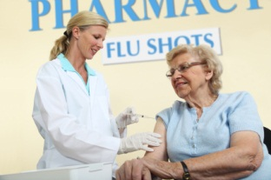
Flu Vaccine – 65+
Seniors can opt for same flu shot available to all age groups – or – the
Fluzone High-Dose* vaccine, specially formulated for those aged 65 and older, designed to further stimulate the body’s immune response.
*Fluzone High Dose may carry a greater risk of minor side effects, such as redness, swelling, fever, head and muscle ache, and malaise. Patients should consult their physician for his/her
recommendation.
Notes:
The same seasonal flu shot given to younger folks may NOT be as effective with seniors, who have a diminished immune response.

Slide 11
Pneumonia
• Leading cause of infectious disease (worldwide).
•Number one cause of death to children under
the age of five (worldwide).
•Fifth leading cause of death among older Americans.
•May be a primary or secondary infection, caused by viral or bacterial agents.
•Bacterial pneumonia the most common form in adults.

Slide 12
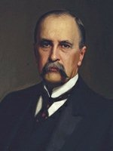
“The Old Man’s Friend”
Pneumonia is “the captain of the men of death.”
Perished from pneumonia in
October 1919.
Authored the highly influential medical text –
The Principles and Practice of Medicine (1892)
Sir William Osler
Father of Modern
Medicine

Slide 13
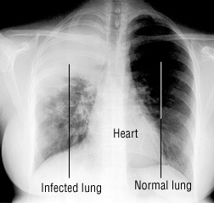
Typical symptoms of pneumonia
(coughing, fever, shortness of breath, chills, chest pain) are not always evident in seniors.
Older patients often suffer from “silent infection,” exhibiting, instead lethargy and
mental confusion. The lack of classical pneumonia symptoms may result in seeking care later,
thereby posing less
successful health outcomes.

Slide 14
Pneumonia Vaccine (PPSV)
Recommended for those aged 65 and older.
Generally issued only ONCE.
(May be required a second time if first vaccination occurred prior to age 65 or in patients with severely compromised
immune systems. Some physicians may recommend immunization every five years.)
Protects against 23 different strains of pneumonia.
The PPS vaccine is covered by Medicare.

Slide 15
Td
T – Tetanus is a bacteriological disease of the nervous system, resulting in lockjaw and difficulty in swallowing. Ten to 30 percent of cases are FATAL, with death rate highest among the elderly.
Not an infectious disease. Tetanus is a bacterial TOXIN found in soil and the waste of domestic and farm animals.

Slide 16
d – Diphtheria is a serious communicable respiratory disease, with a death rate of
10-20 percent. It also carries a risk of complications such as myocarditis and paralysis.
May cause death via suffocation.
Soviet Union outbreak in 1990s resulted in 150,000 cases.

Slide 17
Td Vaccine
Recommended for children (age 7 and up) and ALL adults.
Boosters required every ten years.
The Td vaccine is covered
by Medicare, Part D.
Notes:
Any adult who was not innoculated for tetanus as a child will need a series of THREE tetanus shots for full immunity.

Slide 18
P(ertussis)
More commonly known as whooping cough,
pertussis is a highly contagious respiratory disease, particularly common in young children.
Complications of whooping cough include pneumonia and rib fractures (the result of coughing fits).

Slide 19
Tdap Vaccine
First developed in 2005 (pertussis protection added to Td vaccine).
Recommended for all children and . . .
seniors, aged 65 and over, who maintain close
contact with infants.
Those seniors will need a one-time dose of
Tdap, followed by the ten-year Td boosters.
Tdap is covered by Medicare, Part D.

Slide 20
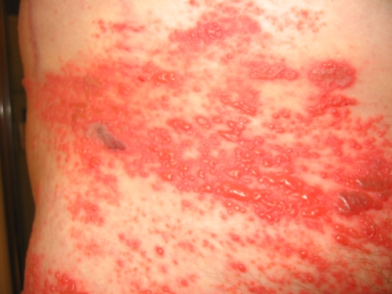
Shingles
A viral disease caused by the same organism responsible for chicken pox, shingles can affect anyone who has ever had chickenpox. The virus lies dormant in the nervous
system and can re-emerge as
shingles at any time in an
individual’s life.
One in three unvaccinated
Americans will suffer from
shingles.
shingles rash
Notes:
The scientific name for shingles is Herpes Zoster (not related to genital herpes).

Slide 21
The most obvious symptom of
shingles (rash) may be itchy and moderately to severely PAINFUL. This pain often continues for weeks or months after recovery from the virus.
Complications of shingles include blindness,
encephalitis (inflammation of the brain), and post-herpetic neuralgia.
At least 50 percent of shingles sufferers are over the age of sixty. Older adults suffer more severe symptoms of shingles than do younger adults.
Notes:
The malingering pain is a condition known as post-herpetic neuralgia.

Slide 22
Zostavax: The Shingles Vaccine
Recommended for those aged 60 and older.
Issued only ONCE.
Covered by Medicare, Part D.

Slide 23
Please Note:
Vaccinations recommended in this presentation are applicable to most
older adults.
Certain illnesses,
conditions, and prescription therapies may warrant postponing or
avoiding vaccinations.
Always consult a
physician.

Slide 24
Detailed information available online:
www.cdc.gov/vaccines/vpd-vac/adult-vpd.htm
www.vaccines.gov/who_and_when/seniors/index.html

Slide 25
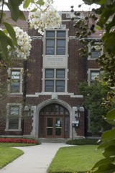
Contact Information:
Bonnie Hinds
218-B Morgan Hall
bhinds@utk.edu
865-974-8178

