Slide 1
Roll Up Your Sleeve for Good Health
Bonnie L. Hinds
June 2012
June 2012

Slide 2
“An ounce of PREVENTION
is worth a pound of
cure.”
Henry de Bracton
1210-1268
Average life expectancy
in 1200s –
43
Notes:
De Bracton was an English lawyer and cleric. His convictions regarding prevention obviously paid off, granting him an extra 15 years beyond the average life span.

Slide 3
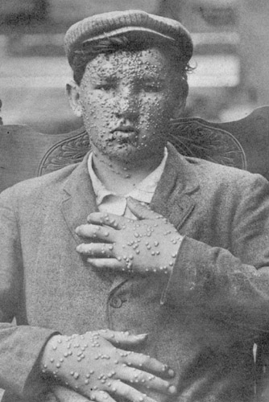
Vaccines are considered to be the most important advancement in the history of human health.
One of history’s deadliest diseases, with a mortality rate of 30 percent or more,
smallpox has been
totally eradicated due to
vaccinations.
Notes:
Smallpox was a worldwide scourge for CENTURIES, killing and permanently debilitating millions of people. Those who survived the disease often suffered significant scarring, blindness, and loss of tissue on the nose, lips, and ears. It is estimated that 400 million people died of smallpox across the world in the 20th century alone. Smallpox is still the only disease that has been 100% eradicated. The last known case was in 1977.

Slide 4
Silly Grownups:
Shots are NOT just for kids:
The “trix” of preventing
illness through vaccines
applies to older adults, too!
Notes:
Most people are well aware of inoculations for infants and young children, but believe—erroneously—that the need for vaccinations ends in early childhood.

Slide 5
Senior Health Considerations
An individual’s immune system becomes less responsive to
health assaults as he/she ages, rendering illness both more
likely and potentially more serious.
Chronic health conditions associated with aging (e.g., hypertension, diabetes, arthritis, etc.) can also make recovery slower and more difficult.

Slide 6
Recommended Vaccinations for
Seniors
Flu
Pneumonia
Td(ap)
(Tetanus, diptheria, pertussis)
Shingles

Slide 7
Influenza (the “flu”)
On average, 36,000 Americans die from the seasonal flu each year. The population most at risk of flu death is the elderly.
Flu shots are required annually, as vaccines are reformulated each year to best combat the particular strain circulating in any given flu season.
An annual flu shot is covered by
Medicare.
Notes:
Encourage everyone you know to get a flu shot. Flu shots are recommended for EVERYONE over the age of six months.

Slide 8
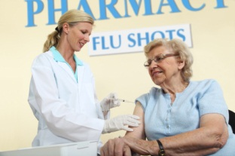
Flu Vaccine – 65+
Seniors can opt for same flu shot available to all age groups – or – the
Fluzone High-Dose* vaccine, specially formulated for those aged 65 and older, designed to further stimulate the body’s immune response.
*Fluzone High Dose may carry a greater risk of minor side effects, such as redness, swelling, fever, head and muscle ache, and malaise. Patients should consult their physician for his/her
recommendation.

Slide 9
Pneumonia
Pneumonia, a lung infection, is fifth among the causes of death in the senior population. As opposed to younger individuals, seniors with pneumonia are hospitalized more often and for longer periods of time and may suffer lasting health problems as a result of the illness.
Because lung function naturally decreases with age,
seniors are more susceptible to pneumonia—and more compromised by its effects—than younger adults.
Notes:
Pneumonia can be a secondary infection, following the flu—emphasizing, again, the importance of an annual flu shot.

Slide 10
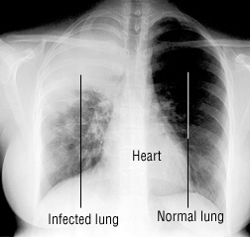
Typical symptoms of pneumonia
(coughing, fever, shortness of breath, chills, chest pain) are not always evident in seniors.
Older patients often suffer from “silent infection,” exhibiting, instead lethargy and
mental confusion. The lack of classical pneumonia symptoms may result in seeking care later,
thereby posing less
successful health outcomes.

Slide 11
Pneumonia Vaccine (PPSV)
Recommended for those aged 65 and older.
Generally issued only ONCE.
(May be required a second time if first vaccination occurred prior to age 65 or in patients with severely compromised
immune systems.)
Protects against 23 different strains of pneumonia.
The PPS vaccine is covered by Medicare.

Slide 12
Td
T – Tetanus is a bacteriological disease of the nervous system, resulting in lockjaw and difficulty in swallowing. Ten-20 percent of cases are FATAL, with death rate highest among the elderly.
d – Diptheria is a serious communicable respiratory disease, with a death rate of ten percent. It also carries a risk of complications such as myocarditis and paralysis.

Slide 13
Td Vaccine
Recommended for children (age 7 and up) and ALL adults.
Boosters required every ten years.
The Td vaccine is covered
by Medicare, Part D.
Notes:
Any adult who was not innoculated for tetanus as a child will need a series of THREE tetanus shots for full immunity.

Slide 14
P(ertussis)
More commonly known as whooping cough,
pertussis is a highly contagious respiratory disease, particularly common in young children.
Complications of whooping cough include pneumonia and rib fractures (the result of coughing fits).

Slide 15
Tdap Vaccine
First developed in 2005 (pertussis protection added to Td vaccine).
Recommended for all children and . . .
seniors, aged 65 and over, who maintain close
contact with infants.
Those seniors will need a one-time dose of
Tdap, followed by the ten-year Td boosters.
Tdap is covered by Medicare, Part D.

Slide 16
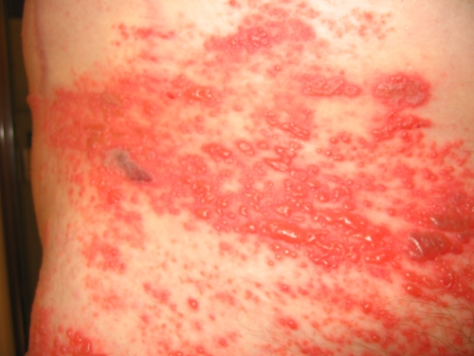
Shingles
A viral disease caused by the same organism responsible for chicken pox, shingles can affect anyone who has ever had chickenpox. The virus lies dormant in the nervous
system and can re-emerge as
shingles at any time in an
individual’s life.
One in three unvaccinated
Americans will suffer from
shingles.
shingles rash
Notes:
The scientific name for shingles is Herpes Zoster (not related to genital herpes).

Slide 17
The most obvious symptom of
shingles (rash) may be itchy and moderately to severely PAINFUL. This pain often continues for weeks or months after recovery from the virus.
Complications of shingles include blindness
and encephalitis (inflammation of the brain).
At least 50 percent of shingles sufferers are over the age of sixty. Older adults suffer more severe symptoms of shingles than do younger adults.
Notes:
The malingering pain is a condition known as post-herpetic neuralgia.

Slide 18
Zostavax: The Shingles Vaccine
Recommended for those aged 60 and older.
Issued only ONCE.
Covered by Medicare, Part D.

Slide 19
Please Note:
Vaccinations recommended in this presentation are applicable to most
older adults.
Certain illnesses,
conditions, and prescription therapies may warrant postponing or
avoiding vaccinations.
Always consult a
physician.

Slide 20
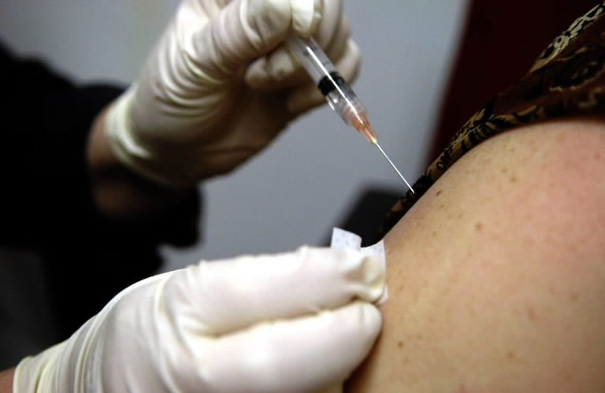
BE Smart;
Be Healthy;
Roll up your sleeve . . . !

Slide 21
Detailed information available online:
www.cdc.gov/vaccines/vpd-vac/adult-vpd.htm
www.vaccines.gov/who_and_when/seniors/index.html

