Slide 1
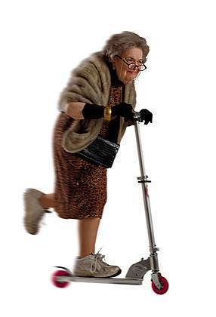
On Your Feet Is in Your Hands:
Fall Prevention for Seniors
Developed by:
Bonnie L. Hinds, M.S.
Environmental Health Programs

Slide 2
The Importance of Preventing Falls:
●More than one third (1/3) of Americans
aged 65 and older fall each year, with
falls accounting for the greatest number of injury-related deaths.
●Falls are the leading cause of fractures and
traumatic brain injuries.
●Fifty percent of individuals who fracture a hip will never again walk without assistance.

Slide 3
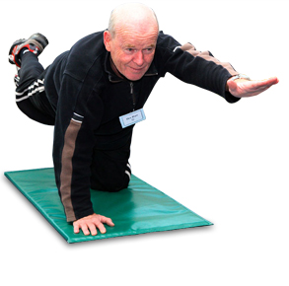
Fear of Falling: The Catch-22
●An innate fear of falling often
deters many older people from
physical activity. Conversely,
reduced levels of activity contribute
to the likelihood of falling.
**Conclusion: Regular exercise is an important preventive measure!!

Slide 4
Health-Related Causes of Falls:
●Impaired Vision accounts for some falls, highlighting the importance of regular eye exams.
●Inner Ear Disturbances are common among seniors and may occur without the telltale symptoms of discomfort or dizziness. A fall without obvious causation indicates the need for a screening. (Smoking, diabetes, and hypertension contribute to inner ear disorders.

Slide 5
Health-Related Causes (continued)
●Some prescription medications may inhibit natural balance, necessitating consultation with a physician.
●Undiagnosed Urinary Tract Infections (UFIs) may result in falls. If you are suffering from incontinence, discomfort, urgency, or other changes in urinary function, consult your doctor.

Slide 6
Home Modification Plan: LIGHTING
● Keeping a home well lit, both inside and out, is essential to fall safety.
●Install night lights in the bedroom, bathroom, kitchen, and stairway.
●Use dusk-to-dawn lights at your home’s entryway.
●Change light bulbs as soon as they burn out.

Slide 7
Home Modification Plan: ENTRYWAY
●Keep sidewalks in good repair.
●Make certain walkway is free
of trip and slip hazards.
●Place a sturdy chair inside
your hallway or mud room for
changing out of boots/wet
shoes.

Slide 8
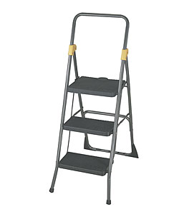
Home Modification Plan: KITCHEN
●Use only non-skid floor wax.
●Dispose of any throw/scatter rugs.
●Store most often-used dishes, glasses, and food
preparation items at waist or easy-to reach height.
●When you must access higher cabinets or shelves, use
only a secure step stool with attached handrail. (Do
NOT use a kitchen chair.)
●Wipe up any kitchen spills IMMEDIATELY.
●Keep a flashlight on hand in case of power
outages.

Slide 9
Home Modification Plan: LIVING ROOM
●Keep clear pathways between furniture items,
removing trip hazards such as magazine racks,
footrests, etc.
●Secure electrical, phone, and other cords away
from pathways (but not under carpet/rugs.)
●Avoid throw rugs.
●Use only chairs/sofas from which you can easily
stand (avoiding those that are deep/low/slouchy.)
●Make certain a light switch/lamp is within easy
reach at the entrance.

Slide 10
Home Modification Plan: STAIRWAYS
●Unsafe stairs account for MANY falls.
The safe stairway features . . .
● light switches at both the top and
bottom.
● railings on BOTH sides.
● slip-resistant surfaces.
●color differential for visual orientation.
●clutter-free surfaces.
●stair lifts for those with disabilities.

Slide 11
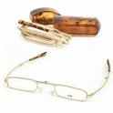
Stairway Safety Tips (continued)
●Avoid going up or down the stairs at the same time
as your pets.
●Don’t carry large objects up or down the stairs.
They can impede vision and prevent you from using
the handrail.
● READING glasses distort depth perception.
Remove before climbing or descending stairs.

Slide 12
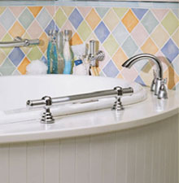
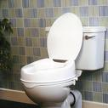
Home Modification Plan: BATHROOM
●Bathrooms are one of the most
common fall sites. Make yours
safer with:
●Grab bars in the tub/shower
●Plastic (rather than glass) shower
enclosures
●Non-skid strips or decals on tub and
shower floors
●Rubberized, slip-resistant bath mats
●Liquid soap dispenser in tub/shower
(rather than bar soap)
●A night light
●A raised toilet seat

Slide 13
Home Modification Plan: BEDROOM
●Maintain a clear pathway from
bedroom to bathroom.
●Install a night light near the
doorway.
●Keep a lamp at your bedside
table and a flashlight nearby.
●If you wear eye glasses, keep
them on your bedside table
each night.
●Sleep on a bed from which you
can easily rise (is not too high
or too soft.)

Slide 14
Fall Prevention: Quick CHECKLIST
●Is your home well illuminated? Are switches, lamps,
and night lights operable and easily accessible?
●Are stairs and pathways free of clutter and trip
hazards?
●Do you have a sturdy step stool in your kitchen?
●Have you discarded throw and scatter rugs?
●Are there grab bars in your bathtub/shower?
●Do you have a flashlight in your kitchen? Your bathroom?
●Can you easily get off/out of your sofa? Your bed?
●Are frequently used items easy to access without a step stool?
●Have you recently had a vision screening? A hearing screening?
●If you have suffered a recent fall without obvious causation, have
you consulted your physician?

Slide 15
On Your Feet IS in YOUR Hands . . .
Falls are not inevitable. Assess your home,
and make modifications to ensure your orthopedic
health.

